Slide 1
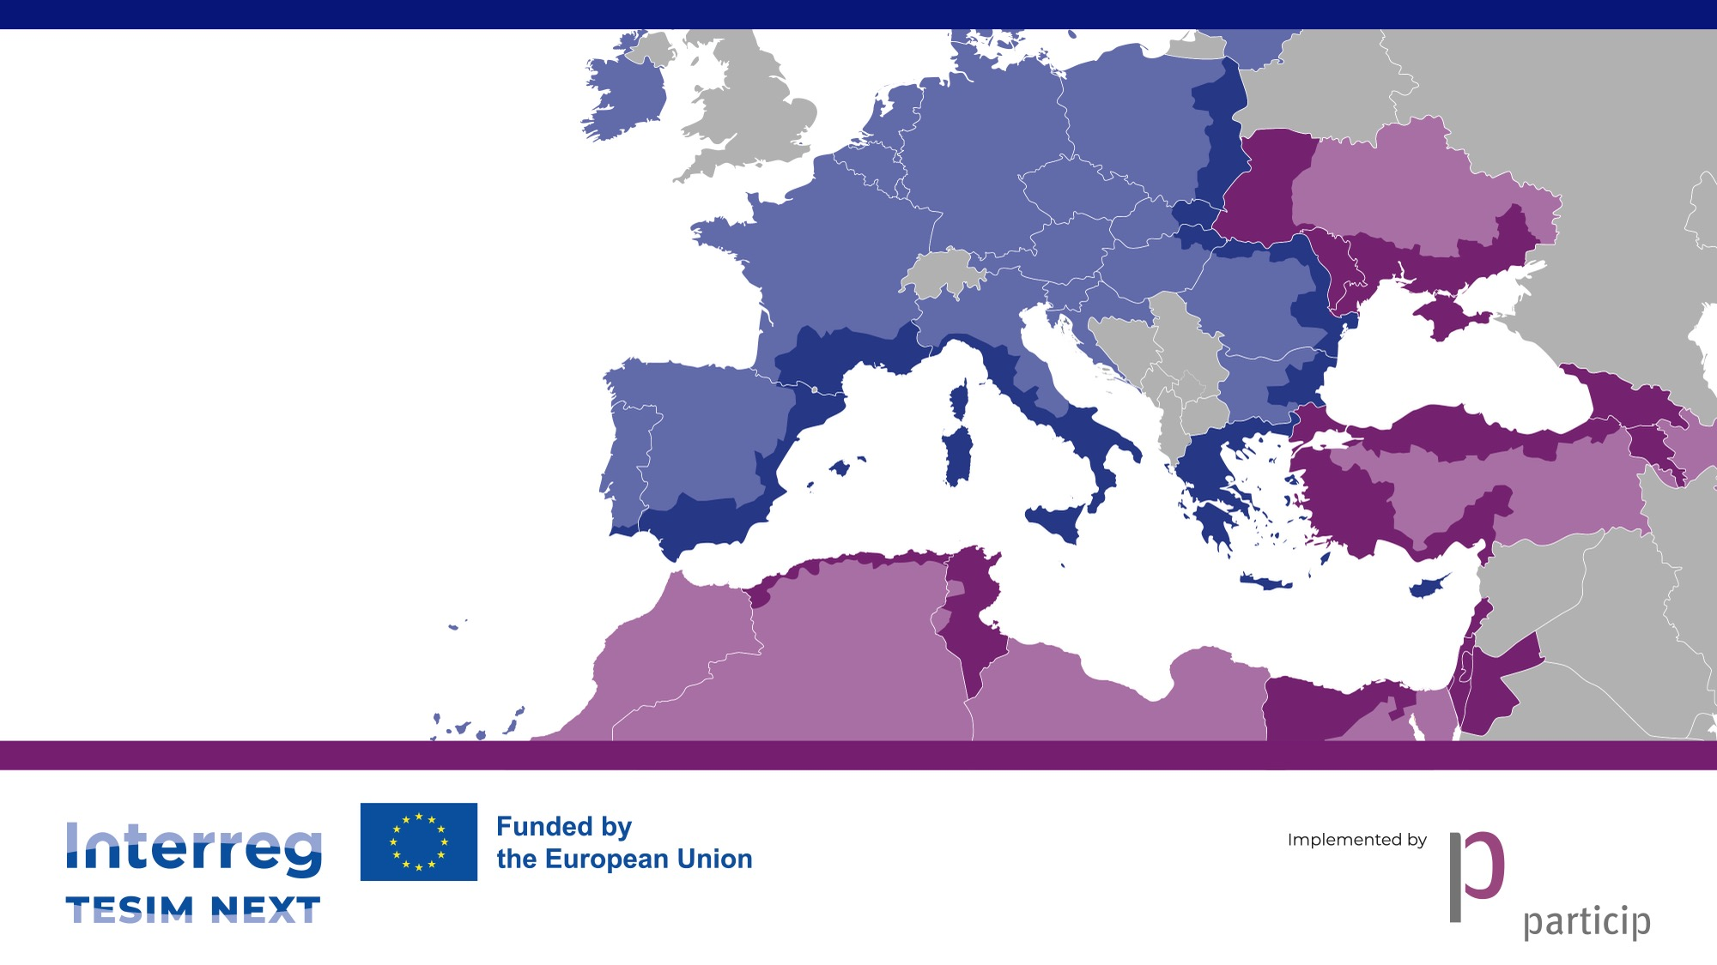
Procurement in Interreg NEXT
Follow-up training for Moldovan beneficiaries
Online, 7 November 2024

Slide 2

Our session today (9:00 – 11:00 AM)
Reminder of procurement rules in Interreg NEXT
Civil contracts
Feedback from programmes
Questions and answers
Key takeaways

Slide 3
Reminder of procurement rules in Interreg NEXT
Follow-up training for Moldovan beneficiaries
Online, 7 November 2024

Slide 4
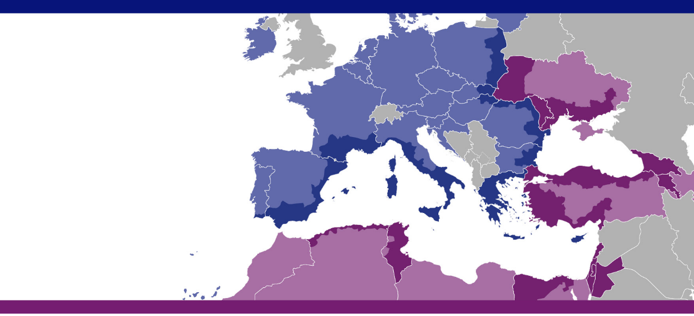


New legal framework

Slide 5
Article 58 of Interreg Regulation
Option 1
Option 2
“Contracting authorities or contracting entities […] located in the Member States, shall apply national laws […] adopted in connection with Union legislation.”
“In all other cases the public or private partners shall apply the provisions set out in Articles 58.2 of the Regulation no 2021/1059 – Financial Regulation (no. 2018/1046).”
Annex II of the Financing Agreements

Slide 6

Which beneficiaries in partner countries?
Do these rules apply to both public and private beneficiaries in partner countries?

Slide 7

DOs and DONTs
Financial Regulation
Annex II of the Financing Agreements
Rules of national legislation for public bodies – which needs to be additional and compatible with Financial Regulation!
PRAG procedures
Usual provisions and procedures of national legislation
Notes:
Monitoring involves much more than the JS – MC, MA also play big part in this process and they use the information collected in the monitoring for their informed decision-making.

Slide 8

TESIM documents on procurement
Compilation of templates
From the EU
Developed by Interreg NEXT/IPA programmes
From PRAG (without adaptation)
From PRAG (adapted by TESIM)

Slide 9
Annex II of the Financing Agreement

Slide 10
A structured compilation of the rules in Financial Regulation
A. General provisions
B. Types of procedures
C. Preparation
D. Technical specifications and criteria for assessment
E. Submission, evaluation and award decision
F. Contract performance
No restrictions on nationality of tenderers and origin of goods, except for sanctions (https://www.sanctionsmap.eu/#/main )

Slide 11

Types of procedure by publicity
Open procedure
Restricted procedure
Local open procedure
Simplified procedure (competitive with negotiation)
Direct award
Direct payment against invoice
Negotiated procedure without prior publication

Slide 12
Thresholds
Procedure | Services | Supplies | Works
Open or restricted (OJEU) | ≥ 300 000 EUR |  | ≥ 5 000 000 EUR
Local open | N/A | ≥ 100 000 EUR < 300 000 EUR | ≥ 300 000 EUR < 5 000 000 EUR
Simplified procedure | > 20 000 EUR < 300 000 EUR | > 20 000 EUR < 100 000 EUR | > 20 000 EUR < 300 000 EUR
Single tender | > 2 500 EUR ≤ 20 000 EUR
Payment against invoice | ≤ 2 500 EUR
Check the threshold for the procedure in Euro by using the exchange rate of the month of the launch of the procedure in Inforeuro
https://commission.europa.eu/funding-tenders/procedures-guidelines-tenders/information-contractors-and-beneficiaries/exchange-rate-inforeuro_en

Slide 13
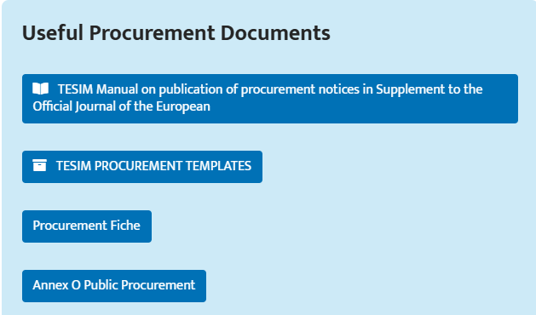
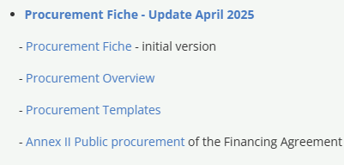
Go to the programmes’ websites for info & documents
https://www.blacksea-cbc.net/interreg-next-bsb-2021-2027/programme-documents
https://ro-md.net/en/projects/useful-in-implementation

Slide 14

A key challenge for eligibility of expenditure!!

Slide 15
Key messages
Effective and compliant procurement is necessary for project success
Errors in procurement have a higher impact with simplified cost options
Forget the past, invest in knowledge of the new rules
Use compliant templates (check your own ones with the rules)
Procurement needs time
Prevent fraud and corruption

Slide 16

Please remember this is just a limited walk-through …

Slide 17
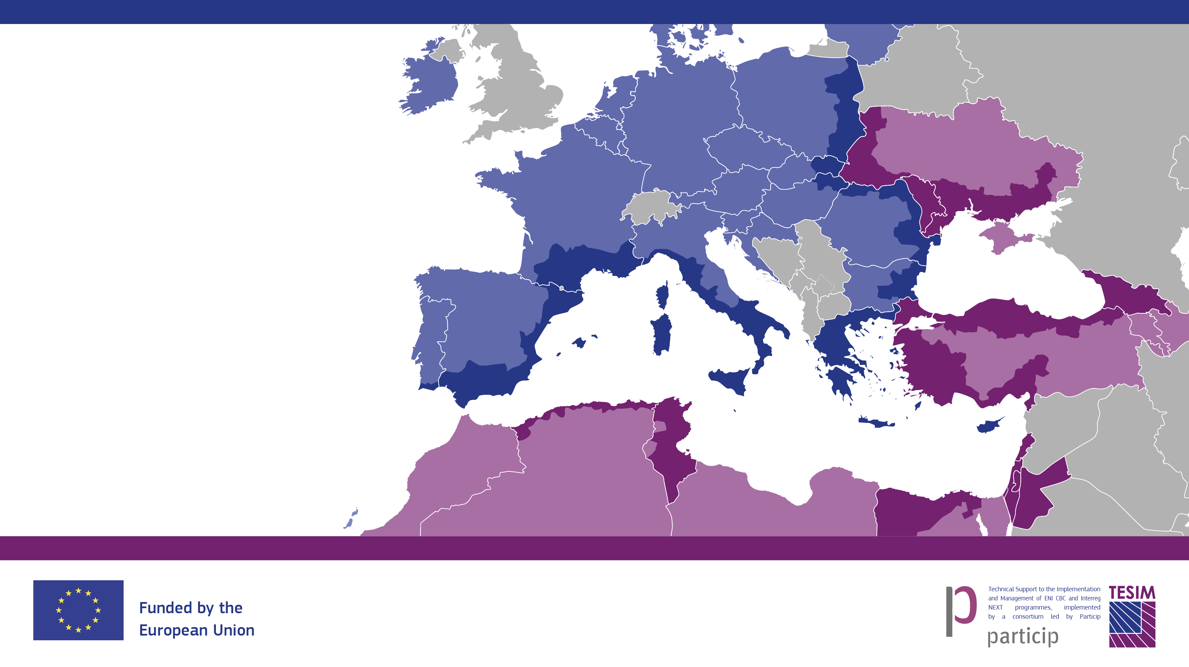





… you need to
Remember to:
Follow us on
Visit our website, check our library and take a tour in our exhibition of projects
Subscribe to our bulletin and to our “News from the Regions”
Because neighbours matter!

Slide 18
Civil contracts
Follow-up event on for Moldovan beneficiaries
Online, 7 November 2025

Slide 19
Reminder of eligibility rules for staff
Article 39(2) of Interreg Regulation
“Staff costs shall be limited to the following:
salary payments related to the activities which the entity would not carry out if the operation concerned was not undertaken, provided for in an employment document, either in the form of an employment or work contract or an appointment decision, or by law, and relating to responsibilities specified in the job description of the staff member concerned;
any other costs directly linked to salary payments incurred and paid by the employer, such as employment taxes and social security including pensions […];
[…] payments to natural persons working for an Interreg partner under a contract other than an employment or work contract may be assimilated to salary payments, and such a contract shall be considered to be an employment document.
May the last paragraph be applied to civil contracts?

Slide 20
Civil contracts in the Republic of Moldova
In the Republic of Moldova, the method of contracting a natural person (without entrepreneur status) other than individual employment contract is through a service contract concluded in accordance with the Civil Code (“civil contracts”).
The use of the civil code for a service contract does not preclude the need for a procurement procedure following Annex II of the Financing Agreement
Only the cost of project staff contracted after a recruitment procedure can be allocated to the “staff” category. Any service contract, must be allocated to “external services and expertise”.
An example of non-employment contracts assimilated and allocated to “staff” category is the case of civil servants.

Slide 21
Civil contracts in the Republic of Moldova
In summary, may civil contracts be allocated to the category “staff” in the Black Sea Basin and Romania-Republic of Moldova programmes?
NO

Slide 22


Programul Interreg NEXT VI-A
România – Republica Moldova
Programul Interreg NEXT VI-B
Bazinul Mării Negre
Sesiune instruire Beneficiari
07 Noiembrie 2025

Slide 23
Regulile privind achizițiile
Beneficiarii Autorități Contractante din România legislația națională
TOȚI Beneficiarii din Republica Moldova Regulamentul Financiar nr. 2509/ 2024 (Anexa II)
Beneficiarii din România care nu sunt AC Regulamentul Financiar nr. 2509/ 2024 (Anexa II)
ATENȚIE!
În cazul în care regulile de derulare a achizițiilor nu vor fi respectate, Controlorii/ AM (Autorizare) vor aplica corecții financiare în conformitate cu Decizia CE nr. 3452/ 2019!
Pentru toate cheltuielile bugetate la capitolele External Expertise, Equipment și Infrastructure trebuiesc derulate proceduri de achiziție.

Slide 24
ATENȚIE!
Cheltuielile efectuate se raportează în moneda în care au fost plătite, Jems efectuând automat transformarea în euro la cursul Inforeuro din luna solicitării controlului.
În procesul de autorizare nu se verifică cheltuielile nevalidate de controlori. În cazul în care nu sunteți de acord cu rezultatul controlului, aveți posibilitatea să transmiteți către acesta o contestație în vederea soluționării.

Slide 25
Greșeli comune de raportare din Programe similare
Anexe lipsă sau necompletate corespunzător;
Link-uri create către secțiunea Procurement din Jems pentru achiziții directe mai mici de 10.000 euro pentru Programul Interreg NEXT România-Republica Moldova și 2.500 euro pentru Programul Interreg NEXT Bazinul Mării Negre;
Link-uri create către secțiunea Investment din Jems pentru cheltuieli aferente liniilor bugetare Equipment și External Expertise;

Slide 26
Greșeli comune de raportare din Programe similare
Cheltuielile de travel aferente experților (External expertise) vor fi incluse în contractele respective de servicii și se vor raporta la linia bugetară External expertise – NU la Travel!
Neîncărcarea tuturor documentelor justificative și a documentelor aferente procedurilor de achiziții;
Contract de servicii încheiat cu unul din reprezentanții legali ai partenerului ALERTĂ DE FRAUDĂ;

Slide 27
Greșeli comune de raportare din Programe similare
Salariile echipei de proiect și taxele aferente raportate bulk – acestea trebuiesc raportate pe fiecare membru/ pe fiecare lună;
Cheltuielile solicitate la rambursare nu respectă bugetul aprobat, nu se respectă încadrarea pe sub-linii bugetare și a bugetului detaliat:
- Per-diem raportat la capitolul Salarii;
- Salarii decontate la capitolul External Expertise

Slide 28
Mulțumesc!

Slide 29
Questions & answers on procurement
Follow-up training for Moldovan beneficiaries
Online, 7 November 2024

Slide 30
Questions received
General questions
Preparation of documents
Award
Questions not related to procurement (not answered)

Slide 31
General questions

Slide 32
General questions
Question | Answer
Is it acceptable to pay invoices for goods and services procured under the project prior to the presentation and acceptance of expenses by the auditor? | The controllers (private auditors) will only check paid invoices. Any non-paid invoice will be “parked” to the next reporting period.
What types of timesheets will we use? | This question does not relate directly to procurement, except for services contracts paid on the basis of daily or hourly fees. The programme does not propose any template of timesheet.
Multi-year contract, is it allowed to contract the economic agent for the provision of services over 1-2 years? | Yes. In fact, annual contracts for the same service would be considered as artificial splitting.
Procurement of services specifically according to annual budget planning? | This question need clarification: it refers to project annual budget or institution annual budget? Private or public body?

Slide 33
General questions
Question | Answer
Is the procurement plan approved annually, or for the entire implementation period? | Ideally the entire implementation period, as procurement may be a lengthy process
How do we plan procurement if no sources have been allocated in the institution's budget at the moment? | You need to plan procurement in a realistic, that is, bearing in mind the time needed to allocate the project budget into the institution’s budget
What is the exact procedure for managing the public procurement process? · According to which templates do we prepare the procurement file? · Is there an approved Guide at the level of the Republic of Moldova regarding procurement rules? · What is different from the previous Program? | Please refer to the procurement documents in the programme’s website: Black Sea Basin: see “procurement fiche” in https://www.blacksea-cbc.net/interreg-next-bsb-2021-2027/programme-documents Romania-Republic of Moldova: see ”useful procurement documents” in https://ro-md.net/en/projects/useful-in-implementation

Slide 34
General questions
Question | Answer
In the case of projects financed from external funds, where the rules in Annex II are applied, it is worth noting that contracting authorities in the Republic of Moldova have access only to the MTender platform (the national platform for publishing tender notices), what is the correct solution for initiating procurement procedures? Is publication on the MTender platform sufficient, or must the transmission of invitations to participate to economic operators also be ensured (according to the requirements stipulated in point 2 letter d) and point 5 subpoint 5 (point B Types of procedures), of Annex II - Public procurement)? | Publication in Mtender is sufficient for local open procedures. International procedures have to be published also in the OJEU. No tender notice must be published for simplified procedure or single tender.

Slide 35
General questions
Question | Answer
Considering that the procurement documents are in Romanian, will the Declarations below be completed in Romanian or in English? (annex 6, 7, declaration of honour, declaration of impartiality ) I think that not everyone is familiar with English and you can't even stipulate that the documents presented be in English? | Supporting documents may be completed in Romanian.
At one of the trainings we were told that: "For public procurement, the following fields are mandatory: Beneficial owner(s) of the contractor/Subcontract(s)/Attachment(s)". I understand correctly that this provision (to indicate the Beneficial Owner) is only for public authorities, so we, as a university, have nothing to do with it? | The requirement to collect information about the beneficial owners of contractors and subcontractors concerns all project beneficiaries, regardless of their legal status

Slide 36
General questions
Question | Answer
Regarding Conflict of Interest: the Procurement fiche states that “There is no (sub)contracting services/supplies/works to the staff of the Partner”. Does this only apply to project staff, or to all employees of the institution? | Any employee of the partner institution

Slide 37
Preparation of procedures

Slide 38
Preparation of procedures
Question | Answer
What standard form do we use for the participation notice in the case of the procurement procedure for goods with a value exceeding 300 thousand euros (open procedure). | Template I2 in TESIM’s compilation. This tender must be published in the Official Journal of the European Union. See TESIM document on how to publish it there, available on the website of Romania-republic of Moldova programme.
EU regulatory acts (annex 2) of the Financial Regulation provide for a procedure up to 2,500, LP1 insists on applying the tender procedure, how do we proceed? | It is not the role of the LP to validate the eligibility of expenditure, but the controller and the programme bodies. Please proceed with the procedure as described in Annex II of the Financing Agreement.
In what language is the procurement documentation prepared? | Procurement documents can be prepared in local language. International tenders must be published also in English.

Slide 39
Preparation of procedures
Question | Answer
Considering the provisions of art. 28 para. (2) of Law no. 131/2015 on public procurement, which requires the publication of the notice of intent in the Official Journal of the European Union (OJEU) for contracts with an estimated value greater than 2,300 million lei for goods and services, and the provisions of Annex II, point 3, subpoint 1 of the Financial Agreement, which establish the obligation of publication in the OJEU for contracts with a value equal to or greater than 300,000 euros (the equivalent of 6 million lei) for goods and services. What is the applicable threshold for determining the obligation to publish the notice of intent in the OJEU within the framework of projects financed by the Financial Agreement — the one provided for by national legislation or the one indicated by the Financial Agreement? | The thresholds in Annex II prevail for all types of procedures. The thresholds in the national legislation are not applicable.

Slide 40
Preparation of procedures
Question | Answer
P.5, subpt.1 letter c), what is meant by local open procedure? | “Under the local open procedure, the contract notice shall be published at least in the official gazette of the recipient State or in any equivalent publication for local invitations to tender”.
P.5, subpt.4, the notice of participation in the case of local open procedure is published in the official bulletin of the recipient state or in any equivalent publication for local invitations to participate in the tender. Question: By the official bulletin of the recipient statute do we mean one of the public procurement platforms such as Mtender, procurements? | Yes, Mtender is an “equivalent publication”, as mentioned in Annex II

Slide 41
Preparation of procedures
Question | Answer
P.12 subpt.2. "The granting authority shall indicate the elements defining the minimum requirements to be met by all tenders. Question: How and under what conditions are the minimum requirements to be met by all tenders in the grant award procedure established, and where can the official documentation containing them be obtained? | The grant beneficiary, in its role of contracting authority for tender, should indicate in the procurement documents, such as invitation to tender and tender specifications, which are the minimum requirements. They depend on the nature of the tender.
P.14 subpt.3 a) the tender specifications contain the following: exclusion criteria and selection criteria. Question: Given that the tender specifications include selection criteria, please clarify whether failure to meet these criteria automatically leads to the exclusion of the economic operator from the procurement procedure or whether it is necessary to include separate exclusion criteria to determine the ineligibility of tenderers. | Failure to meet the criteria automatically leads to exclusion

Slide 42
Preparation of procedures
Question | Answer
P.14 subpt.3 letter e) proof of access to procurement. Question: What do you understand by "proof of access to procurement" in the context of public procurement procedures and what are the accepted documents or means to demonstrate this access? | For open procedures, access to all procurement documents in e-Platform or website. For simplified and single tender, proof of transmission of all documents to the tenderers
Question: Are the procedural documents used for the procurement of goods under projects the same as those applied in standard procurements or is a distinct set of specific documents used? | You need to ensure that the documents comply with the requirements in point 14 of Annex II. They can be adaptations of your usual documents, TESIM’s templates or other.

Slide 43
Preparation of procedures
Question | Answer
Can we combine the procedure, namely to launch the procurement on MTender, and in parallel to send direct invitations to economic operators, to ensure that a minimum of three offers are received? | You cannot combine procedures. Use Mtender for open procedures and invitations for simplified and single tender. You may inform operators of a publication of an open tender in Mtender by other means, but not send an invitation letter.
Examples of selection criteria for both service and goods procurement. | Minimum annual turnover Experts with at least 5 years of experience in the field Technicians with specific qualifications

Slide 44
Award procedure

Slide 45
Award procedure
Question | Answer
What types of forms are used for the minutes of opening and evaluating offers? | There is no proposed template neither by the programmes, nor by TESIM for the opening session. Please use your own template. There are some optional templates proposed for the evaluation grid and the evaluation report in TESIM’s compilation of templates.
Correct completion and presentation of the standard forms required for opening and evaluating offers, and their annexes, both for the acquisition of services and goods. | There are no compulsory templates, except for the declaration on honour for which use the compulsory form. As a general principle, any procurement document must be correctly filled-in and uploaded to Jems as part of the tender dossier.

Slide 46
Award procedure
Question | Answer
Is it necessary or not to establish an Evaluation Committee at the institutional level? | Not mandatory for payment against invoice and single tender procedure. Mandatory for all the other usual procedures, with some exceptions for framework contracts and negotiated procedure.
Is there a legal provision that establishes the role, powers and operating principles of the Evaluation Committee? (P.S. in Annex II of the RM-EU-Interreg Financing Agreement there is only one provision - art. 24, point 5) | There are no specific provisions in Annex II. Therefore, we recommend you applying your usual procedures. Please take special care on the prevention of conflict of interest.

Slide 47
Award procedure
Question | Answer
In the case of simplified procedures, PRAG provides for the obligation to receive a minimum of three offers, while national legislation (Law no. 131/2015) allows the procedure to be carried out with a single valid offer. In such situations, which rule prevails and how should we proceed to avoid the risk of non-compliance or financial corrections? | “If, following consultation of the tenderers, the contracting authority receives only one tender that is administratively and technically valid, the contract may be awarded provided that the award criteria are met.” Point 5.5 of Annex II. REMIND: NEITHER NATIONAL LEGISLATION NOR PRAG ARE APPLICABLE
If, even after sending the invitations, three compliant offers are not obtained, can the procedure be continued according to national rules or must it be resumed to comply with PRAG? | You need to send again invitations. REMIND: NEITHER NATIONAL LEGISLATION NOR PRAG ARE APPLICABLE

Slide 48
Award procedure
Question | Answer
In the case of simplified procedures, according to national provisions, is it necessary to complete the Report and the Award Notice upon completion of the procurement procedure | Annex II does not stipulate any provision on the report and award notice for simplified procedure. Therefore, you may use the national provisions.

Slide 49
Questions not related to procurement

Slide 50
Questions not related to procurement
Question
Does the modification of allocations between ECOs (if necessary) require mandatory coordination with project partners?
Will salary expenses be calculated depending on the expenses incurred with the application of the 4% threshold (of total expenses) or is it possible to calculate them equally throughout the project? That is, the total amount provided for 24 calendar months.
Is it mandatory to attach to the timesheets that is, the monthly work performed?
Can the expenses be made according to a schedule other than the one distributed by periods?
When and under what conditions can an application for the next tranche be made?
Is it allowed to accept offers that exceed the amount established by the beneficiary of the grant contract until the launch of the procurement procedure?

Slide 51
Questions not related to procurement
Question
In accordance with Article 40 of Regulation (EU) 1059/2021 on Office and Administrative Costs, under point (d) referring to office supplies, we kindly request clarification on which types of items can be considered eligible under this category. Specifically, we would like to understand whether, in addition to standard consumables (such as paper, pens, folders, toner), the category may also include longer-use office items, such as small office equipment (e.g., telephone, fax), and if so, under what conditions.
In what language are the narrative and financial reports for evaluating progress after each implementation stage prepared?

Slide 52
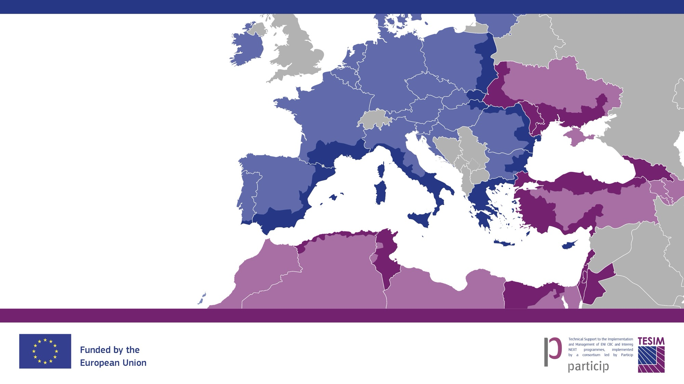




Any additional questions, comments or feedback?
Remember to:
Follow us on
Visit our website, check our library and take a tour in our exhibition of projects
Subscribe to our bulletin and to our “News from the Regions”
Because neighbours matter!

Slide 53
Key takeaways
Follow-up training for Moldovan beneficiaries
Online, 7 November 2024

Slide 54
Key takeways
New rules: read carefully and use Annex II of the Financing Agreements
PRAG is not applicable anymore
National legislation is applicable only for what is not provided at all in Annex II

